Slide 1




TOURIST PLACES IN BANGLADESH
Sifat Bin Hamid
IS – 08

Slide 2


WELCOME TO PRESENTATION
I’m Sifat Bin Hamid, and I’ll show you some of the most famous tourist places in Bangladesh.

Slide 3
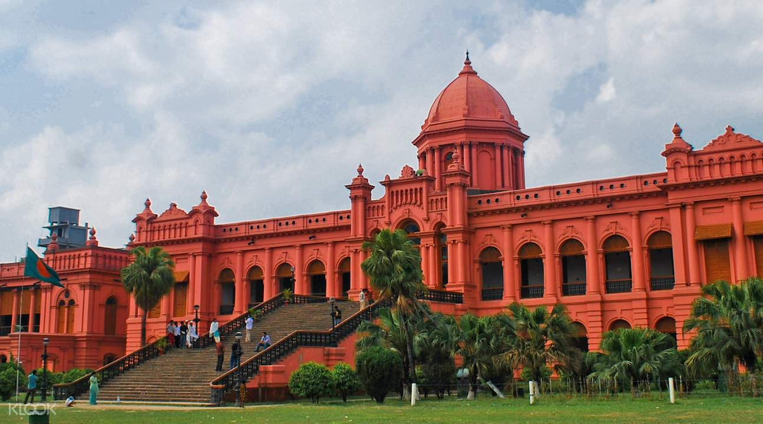
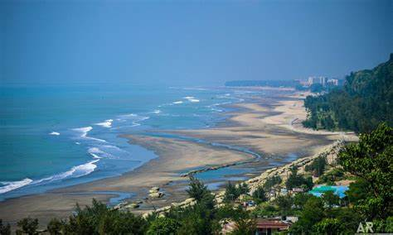
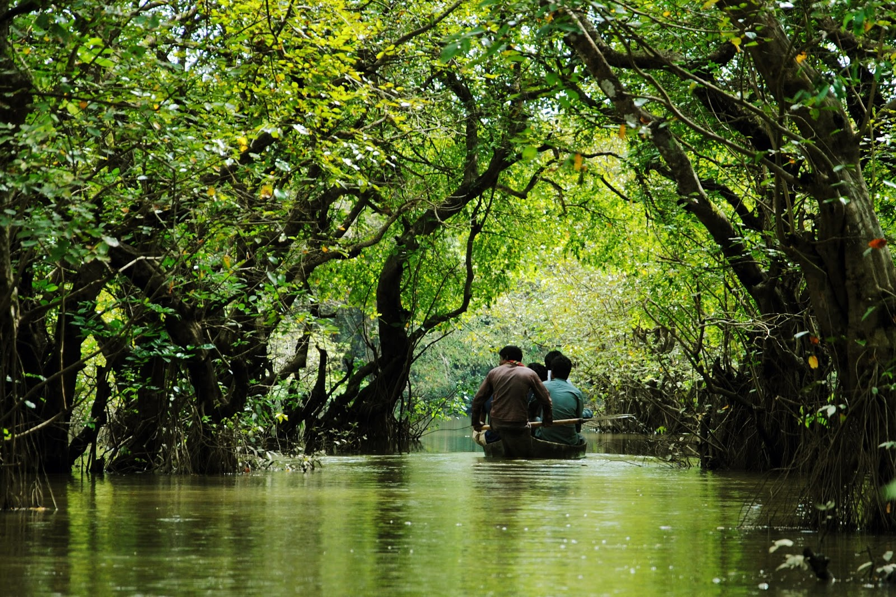
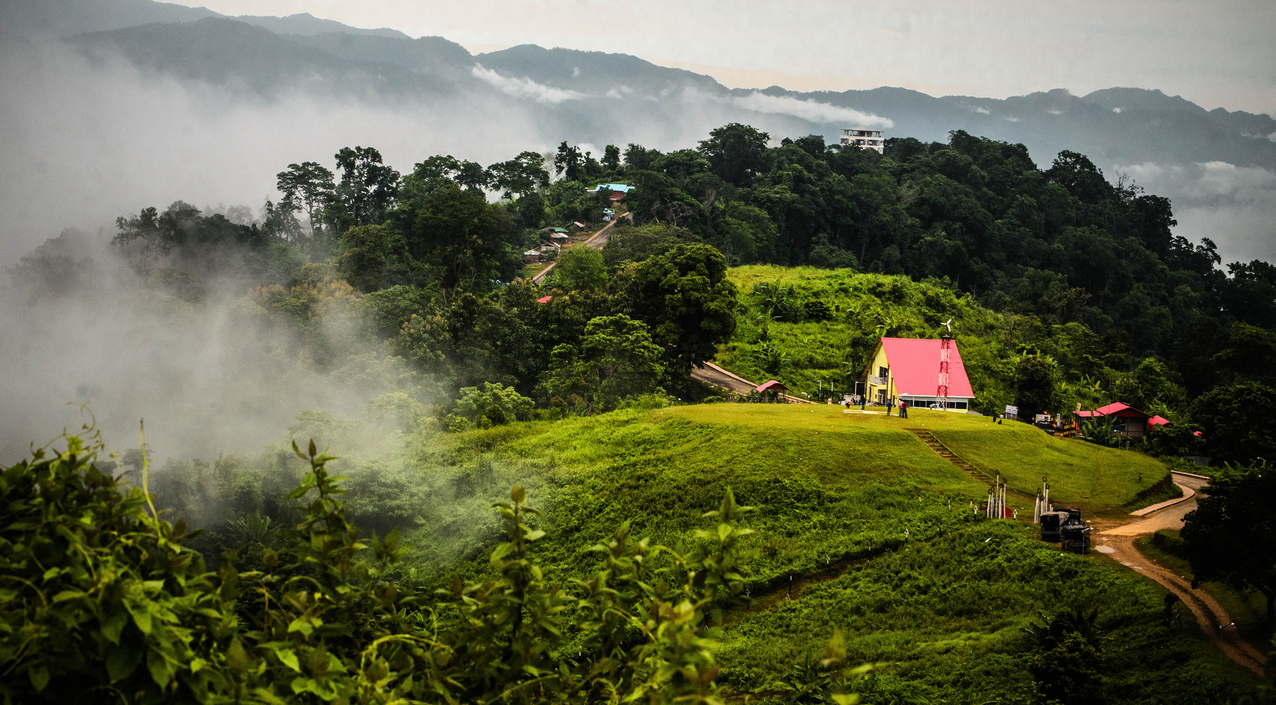

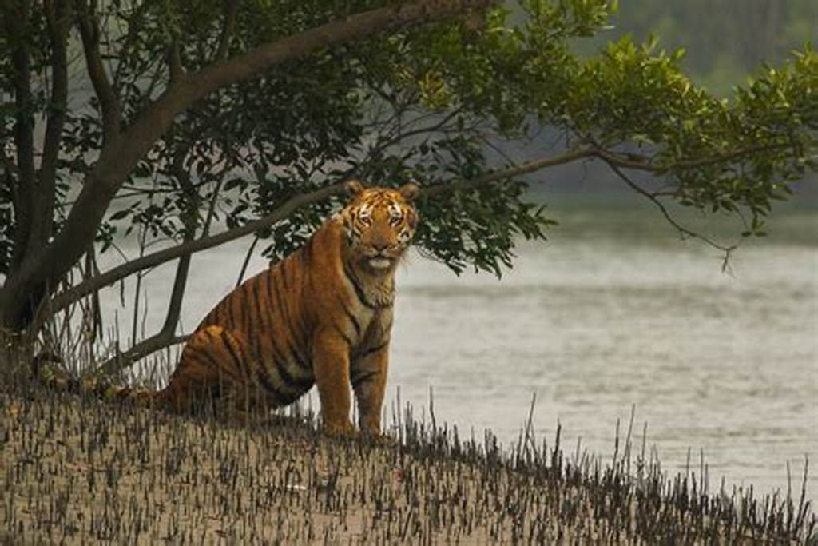
TABLE OF CONTENTS
1. Ahsan Manzil
2. Cox’s Bazar
3. Ratargul
4. Sajek Velly
5. Mana Bay
6. Sundarbans

Slide 4
Ahsan Manzil
Ahsan Manzil is a historic palace located in Dhaka, the capital of Bangladesh. It is one of the most iconic landmarks in the city, known for its architectural grandeur and rich history.
The building originally served as the residential palace of the Nawabs of Dhaka, the affluent aristocratic rulers who played a significant role in the region during the 19th century.

Slide 5
Cox’s Bazar
Cox's Bazar is a coastal city in southeastern Bangladesh, renowned for having the longest natural sea beach in the world. Stretching over 120 kilometers (75 miles), this stunning beach along the Bay of Bengal is one of the country's most popular tourist destinations..
Cox's Bazar is not just a beach destination but also an area with a rich cultural heritage, diverse ecosystems, and a perfect getaway for those looking to experience the natural beauty and tranquility of Bangladesh’s coastline.

Slide 6
Ratargul Swamp Forest
Ratargul Swamp Forest is a unique and stunning freshwater swamp forest located in the Gowainghat Upazila (sub-district) of Sylhet, in northeastern Bangladesh. It known for
its enchanting beauty and serene environment, it is one of the few swamp forests in the world, with its floating and submerged trees making it a remarkable natural wonder.

Slide 7
Sajek Velly
Sajek Valley is a stunning tourist destination located in the Chittagong Hill Tracts, specifically in the Rangamati district of Bangladesh. It is often referred to as the "Queen of Hills" due to its breathtaking beauty, lush greenery, and panoramic views of the surrounding hills and valleys.

Slide 8

Mana Bay Water Park
Mana Bay is Bangladesh's first premier water park, offering an unparalleled blend of excitement and relaxation. As the largest water theme park in Bangladesh and the third largest in South Asia.

Slide 9
Sundarbans
The Sundarbans is one of the most famous and ecologically significant mangrove forests in the world, located in the southwestern part of Bangladesh and eastern India. Spanning approximately 10,000 square kilometers, the Sundarbans is a UNESCO World Heritage Site and is renowned for its biodiversity, unique ecosystem, and its role in protecting coastal areas from storms and erosion.

Slide 10
Thanks
for
Staying with Us

